Slide 1
Town Hall Clothes Bank

Slide 3
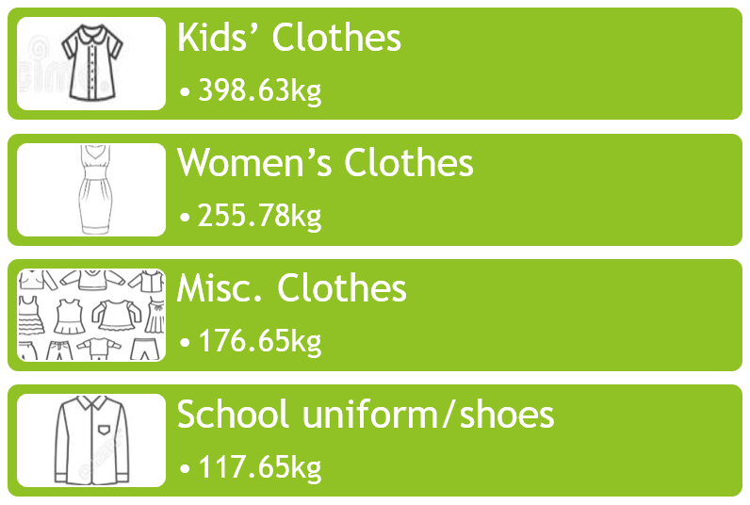

Slide 4
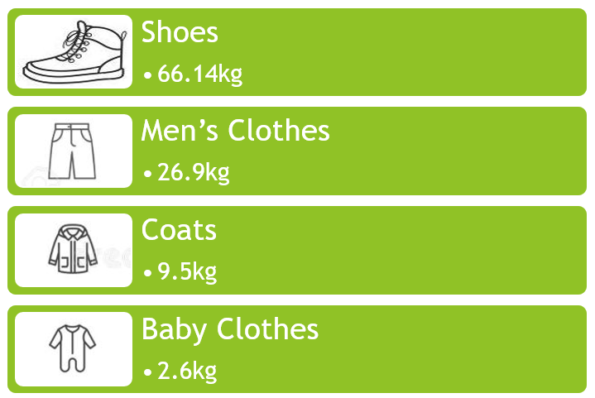

Slide 6
